Slide 1
Finding the light source position with steel spheres

Slide 2
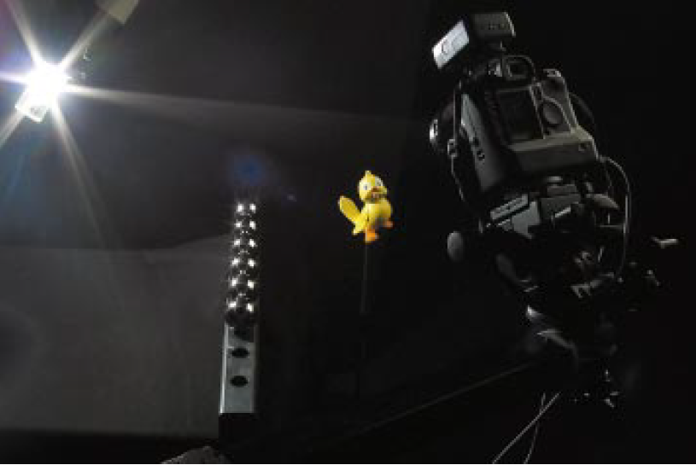
Introduction
Finding the position of the light source is important.
We will introduce the method of recovering the point light source with steel spheres. This method doesn’t require any user interaction.
Conditions:
Steel spheres have all the same diameter, and the spheres are lying on a straight line at an equal and known distance.
Fig. 1. Experiment Settings
The method consists of two processes:
1. Finding the position of spheres with ring flash highlight
2. Recovering the light source position based on the reflection of the light

Slide 3
Method – Find Camera Intrinsic Parameter
Use Zhang’s method [1] to find the Intrinsic parameter
We can evaluate a directional vector from the origin of the camera to a certain pixel
[1] Zhang, Z. 1999. Flexible Camera Calibration By Viewing a Plane From Unknown Orientations. In Proceedings of the International Conference on Computer Vision. 666–673.

Slide 4
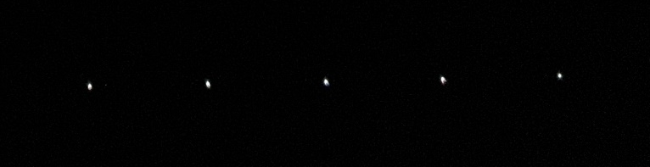
Method – Find the Exact Highlight Position in the Image
We have to find the exact highlight pixel in the image. (Use for ring flash and light source highlight)
Fig. 2. Cropped image of ring flash highlights
Considering the peak of each dimension, we can find bright pixels automatically and accurately!
In the image of highlight points, there are 3 elements in each pixel: x, y, and intensity.
We binarize the raw image using the image threshold with Otsu’s method [2], and consider the center of the rectangle containing the connected bright pixels as the highlight point.
[2] M. Sezgin & B. Sankur (2004). "Survey over image thresholding techniques and quantitative performance evaluation". Journal of Electronic Imaging.

Slide 5
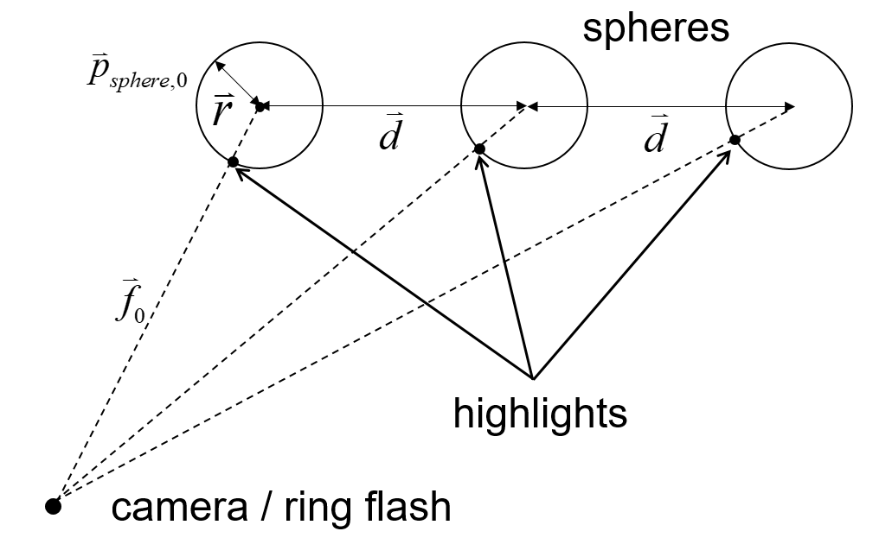
Method – Find the Position of the Spheres
The ring flash of the camera shows a highlight in the center of the spheres.
Using intrinsic parameters, we can get direction vectors of the highlights in the image.
Fig. 3. Ring flash yields a highlight to the spheres

Slide 6
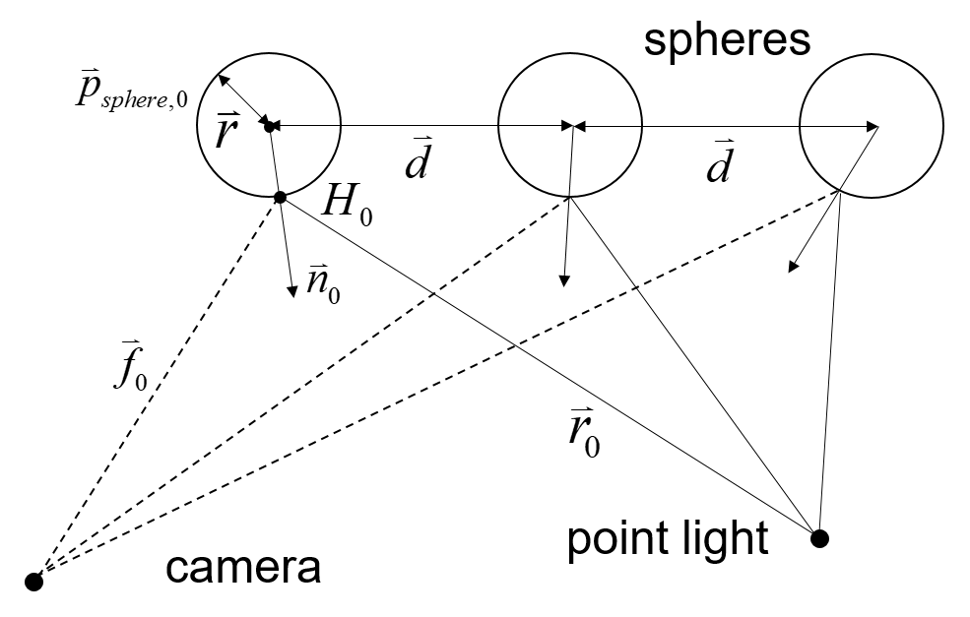
Method – Find the Position of the Light Source
In this step, the highlight point is the reflection point of the point light source.
Fig. 4. Light source highlight from the point light

Slide 7
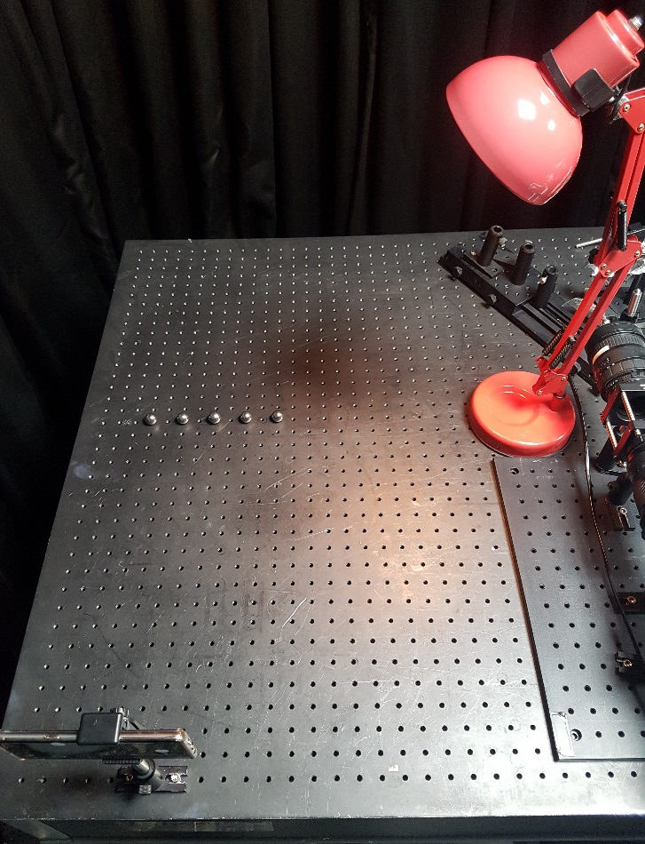
Experiment – Settings
Ring flash light: smartphone flashlight
Point light source: lamp with a light bulb
Steel sphere: 5 steel spheres, r = 1.5cm
Camera: image pixel = 1440x1080, shutter speed = 1/8000 s
Fig. 5. Shows the acquisition setup of this experiment.
Intrinsic parameter of the camera (pixel) :
We calculated the position of the light source by changing vector d and p, then analyzed the factor affecting the error through comparison with the actual value.
Fig. 5. Acquisition setup

Slide 8


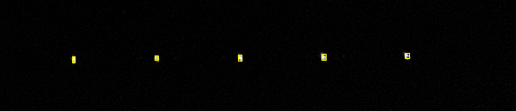
Experiment – Select highlight pixels from raw image
Find the brightest point using the peak of the intensity
We used the same method for finding ring flash highlight and light source highlight.
We binarize the raw image using the image threshold, and consider the center of the rectangle containing the connected bright pixels as the highlight point. (See Fig. 8)
Fig. 6. Raw image of the highlight of point light source
Fig. 7. Cropped highlight image
Fig. 8. Automatically selected pixels with binarized image (with small rectangles)

Slide 9
Experiment – Total Result
d (cm) | 1st p (cm) | Error of 1st sphere position (cm) | Error of light position (cm) | Norm of light pos. error (cm)
(5.0, 0, 0) | (0, 17, 50) | (0.21, 3.52, -1.02) | (-11.38, 8.49, 5.07) | 15.08
(7.5, 0, 0) | (0, 17, 50) | (0.30, 3.75, -0.72) | (-6.43, -2.65, 13.44) | 15.14
(5.0, 0, 2.5) | (0, 17, 50) | (0.15, 3.57, -0.93) | (-9.70, 15.94, 7.12) | 19.97
(5.0, 0, 5.0) | (0, 17, 50) | (0.46, 4.07, -0.13) | (0.31, -29.95, 31.62) | 43.55
(2.5, 0, 5.0) | (0, 17, 50) | (0.31, 3.78, -0.58) | (-16.38, -5.89, 5.99) | 18.40
(0, 0, 7.5) | (0, 17, 50) | (0.12, 4.81, 1.90) | (-17.78, 24.33, 11.96) | 32.41
(0, 0, 10) | (0, 17, 50) | (0.45, 4.96, 1.94) | (-37.81, 13.27, 22.58) | 45.99
(5.0, 0, 0) | (0, 17, 60) | (0.49, 4.29, -1.06) | (-18.13, -1.03, 15.62) | 23.95
(7.5, 0, 0) | (0, 17, 60) | (0.45, 4.34, -0.89) | (-13.89, -6.90, 21.71) | 24.10
Table 1. Errors of sphere and light position with d and p
All positions are in camera coordinates (x, y, z). Actual light position = (50,-31.5,50)

Slide 10
Further improvement
Source Code:
https://github.com/kimjw0623/Graduate-research/blob/master/main.py
Need to improve:
Measurement accuracy of the raw images (camera rotation, translation …)
More chrome balls / Size of the chrome balls
Other ways to find highlight point
Proper shutter speed

